Slide 1

Blockchain Design Studio
Tech Mahindra’s Blockchain Business Unit |

Slide 2



$19 bn Revenue
Mahindra Group
100+ Countries
Mahindra Aftermarket
200,000+ Associates
Mahindra Automotive
Mahindra Farm Equipment
Mahindra Financial Services
Mahindra Defence
Mahindra Holidays
Mahindra 2 Wheelers
Mahindra Components
Mahindra Life spaces
Tech Mahindra
Mahindra Partners

Slide 3


$4.7 bn Revenue
90 Countries
INDUSTRY CONNECTS
112,000+ Associates
Banking & Financial Services
Automotive
Insurance
Healthcare & Life Sciences
Communications
Technology, Media & Entertainment
Manufacturing
Retail and Consumer Goods
Public Services
Travel & Logistics
Energy & Utilities

Slide 4


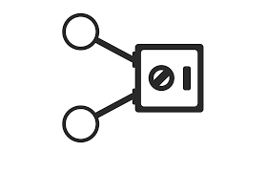















Blockchain Disruption Across Sectors
Digital Rights
E - commerce
Escrows
P2P Lending
Wagers
Micro Finance
SMART CONTRACTS
CRYPTO CURRENCY
Global Payments
Proactive Alarms
BLOCKCHAIN
Resource Sharing
Intellectual Property
DIGITAL ASSETS
RECORDS
Equity
Health Records
Digital Twin
Audit Trail
Loan Securitization
Land Records

Slide 5
Tech Mahindra Blockchain Design Studios
Industry & Geography Wise Outreach
39%
20%
18%
10%
Public
Sector
13%
Our journey began in 2016 – much earlier than most players. With 100+ CXO conversations globally, we have incubated deep capability in blockchain services
Banking
Manufacturing
Telecom
Healthcare
33%
23%
44%
North America
EMEA
APAC
Tech Mahindra Blockchain Enablers
Deep Domain Expertise
20+ Platforms
15+ Partners
Blockchain Design Studios
Several Architects, Developers (Code, UX & UI)
Execution Best Practices
Ask for our Blockchain ‘Platform as a Service’ offerings
Partner Portfolio
Protocol Level Partnerships – Hyperledger, Corda, Ethereum & Others
Application Level Partnerships
Early mover advantage of at least 2 years compared to competition!

Slide 6



Blockchain Design Studios 3 4 3 Strategy
RUN
CHANGE
GROW
3 Blockchain Mega Trends
4 Big Bets
3 CEO Objective
Transformation
Partnerships
Hyperledger
Platform Competency
Consent Management
People Competency
Hands On Production Grade Training
Blockchain As A Service
Design Thinking
Corda
Quasar
Post Chain
Identity management
Trade Finance
Impact & Maturity Assessment
Rapid Deployment
Block Apps
Commercialized blockchain platforms
RUN BETTER
Collaboration
CHANGE
FASTER
Rapid Deployment framework for Services
Business Process Re-engineering
GROW
GREATER
Blockchain ready Resource and Infrastructure for Co-Innovation of future needs

Slide 7

TechM’s Blockchain Ecosystem
150+ Resources
100+ Customers
15+ POCs & Pilots
1 Live Implementation
15+ Partners
Ongoing Projects
Strategic Alliances
Large Indian Public Sector Bank
Large FMCG Giant
Indian Energy Major
Multiple Indian States
Leading Rural Finance Bank
Global Pharma Giant
Telecom Regulatory Body
Global Automotive Giant
R3 Corda
Hyperledger
Ethereum on MS
Multichain
Quantoz
Chromaway
Capability
Market Positioning
Domain SMEs
Blockchain Architects
Chaincode Developers
Demo Ready Use Cases
Studio Set up & Labs
Use Case Repository
Sandbox environment
Analyst Report – IDC, Forrester, Gartner, HfS
Point of View
Marketing collateral
Use Cases across domain
Events- MI, Futurise,
.

Slide 8
Indicative List of Our Work In Various Sector
BFSI
Mfg. / Aero / Consumer Goods
Platforms
Cross-border Payments
IT Audit trail
Invoice Discounting
Trade Finance
Loyalty Points
P2P Process (Ecosystem)
Warranty Services (Claims and Analytics)
Fleet Management
IoT + Supply Chain Provenance
Live Inventory Tracking
Trade Finance
Securitization
Consent Management
Loyalty Management
Identity Management
Vehicle Life Cycle Management
Ownership Management
* Includes 3rd Party and Internally Developed Platforms
Oil & Gas
Healthcare & Lifesciences
Supply Chain Finance
Auctions & Bids
Trade Finance- Credit & Debit Note
Patient Health Records
Patient & Hospital KYC
Master Patient Index
Consent Mangement
Telecom
Government
Mobile Number Portability
Prevention of Roaming Fraud
Unsolicited Commercial Calls
Forward & Reverse Logistics
Land Titles
Vehicle Lifecycle Management
Dept. of Industries

Slide 9
Indicative Platform List
Rapid deployment of multiple chains
No Smart contracts
Scalable Many to Many transactions
Ideal for data sharing and time stamping
Industry use case focus
Enterprise Grade
Fully developed TM capability
Highly secure
Full time support from IBM
Quick POC through Composer
Multichain
Hyperledger
Niche platform for high speed transactions
Highly scalable with distributed computing
Early stage TM capability
No / pluggable Smart contracts
Platforms
We Work On
Good functionality for BFSI
Stronger security at transaction level
Enterprise grade
Early stage TM capability
Full time support from members/ Start ups / R3
Somewhat complex
IOV 42
Corda
Most widely use platform by start ups
Public platform with pluggable security compared to other
Crypto based consensus
Technical support by open source community
Ethereum
Post Chain
Good Functionality for Public Sector Use cases
Simple to use
RDBMS based platform
Lower security on node authorizations
SQL based smart contracts

Slide 10




Tech M Blockchain in News
Honor Award to our Implementation!
Market Research Agencies
Research Paper: Blockchain Disrupting Financial Services
Rated “High Potential” Candidate in Blockchain Enterprise Services report 2017
Featured in ‘Vendor Landscape Guide’ Blockchain Technology Providers In Asia Pacific
Featured in ‘Vendor Landscape Guide’ Blockchain Technology Providers In Asia Pacific

Slide 11

















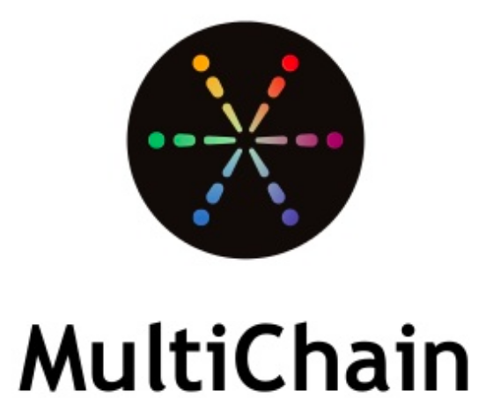


Indicative List of Our Partners
Tech M has a large portfolio of niche partners at both application level and protocol level
Public Sector
BFSI
Manufacturing
HLS
Protocol
ChromaWay
IOV 42
BlockApps
ChromaWay

Slide 12





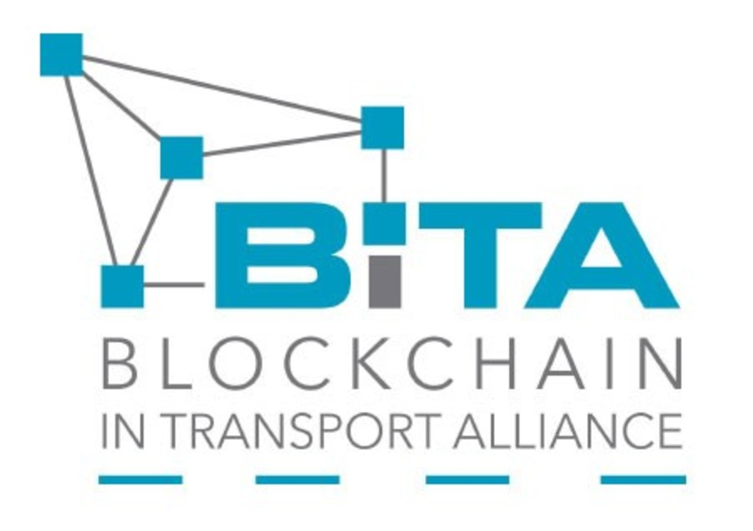




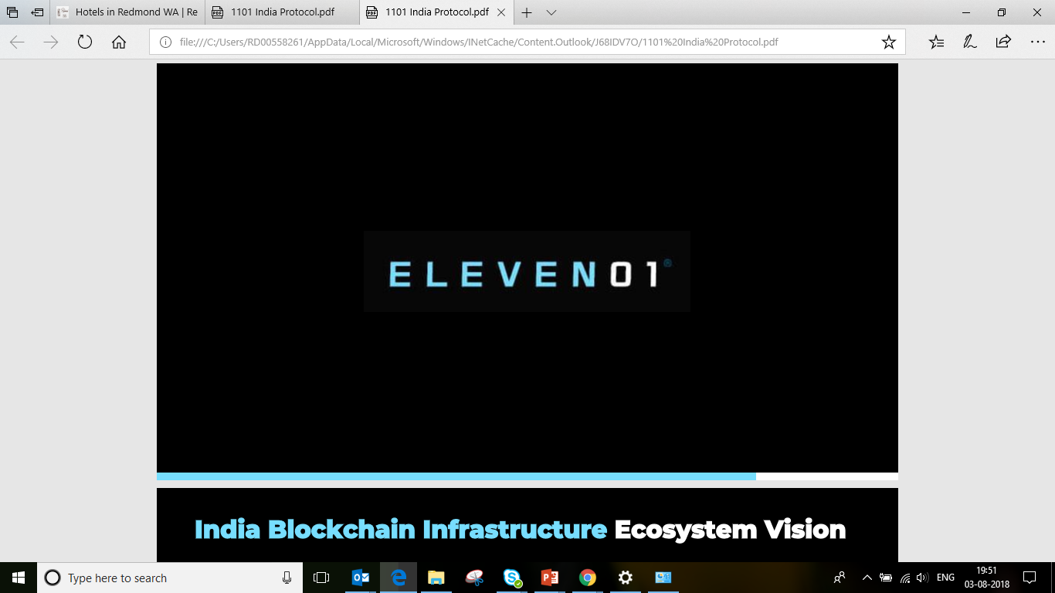






Tapping Innovation in Blockchain
Tech M has a large portfolio of niche partners at both application level and protocol level
Start Up Connect
Protocol Partners
Product Partners
Consortiums
ChromaWay
IOV 42
ChromaWay
BlockApps
We enable start ups and partners to success at our client environments

Slide 13
Blockchain Design Studio
Blockchain Research and Development wing with expertize, experience and association in below:
Start Up Connect
Protocol Partners
Product Partners
Consortiums
ChromaWay
IOV 42
ChromaWay
BlockApps

Slide 14
Various Client Arrangements
We are partners with a number of players in various sector and are working on various arrangements with these players, helping them to deploy blockchain-led solutions
Co-Innovation
Ecosystem Build-out
Technology Implementation Partner
Marketplace
Strategic partnership on digital and innovation initiatives
Collaborative approach – co-work with the identified team/resources in deciphering the candidate use cases for blockchain
Sandbox environment / innovation lab set up
Prototype and pilot
Movement to production of the ones with benefits case
Synthesize the value-chain for the identified business function / process (e.g., supply chain function)
Opportunity identification and business case creation for selected use cases, both upstream and downstream in the ecosystem
Simultaneous / sequential implementation of use cases
Benefits tracking and scaling up
Preferred technology partner for a focused consortium to be built
Build the ecosystem and onboard multiple players
Handle the overall technical responsibility of managing the consortium
Create a platform and value proposition (e.g., trade finance)
Help the client implement the platform and onboard multiple players
Design the cost (Capex + Opex) and revenue models for the client
Run and manage the marketplace platform

Slide 15
Our Blockchain Engagement Model
We have created a simple engagement model and would partner with you in your end-to-end blockchain implementation journey
01
02
03
04
Process
Identification
Scale up
Assess & Educate
Process
Identification
PoC / Prototype
Understand client’s business model
Conduct blockchain knowledge sharing session
Provide application demo
Conduct process discovery workshop(s) to obtain end-to-end info on processes
Shortlist the candidate process for PoC
Develop PoC in the chosen platform to demonstrate the effectiveness
Present the outputs with clearly spelled out benefits
Scale up the current PoC and/or expand to other processes
Establish the transformation programme
System Integration

Slide 16
Why TechM….!
TechM - A strategic Partner
Our Blockchain Center of Excellence is not only capable of delivering Blockchain PoCs, but also has expertise in commercial deployments of the technology supplemented by its rich integration capabilities
Hardware and Software
Networking
Cloud deployment (Private/Public)
Proxy
Firewalls and security
Infrastructural support
Rapid deployment through pre-defined templates (could be tailor-fitted)
Structured approach to solution design
Leveraging x-industry solutions from across sectors
Reusable components
Stakeholder identification
Contracts validation
App development and deployment
App integration
Tailored training modules (tech / non-tech)
Integrating solutions
Resource mix
Blockchain advisors / SMEs
Technical architects
Chaincode developers
UI / UX resources
Platform services
Blockchain platform (vendor selection)
UI technologies
UX framework
Mobile / web enablement
Deployment Options (On Prem / Cloud / Hybrid)
Blockchain + Emerging tech
Blockchain + IoT (Supply Chain)
Blockchain + Data and Analytics / AI
16

Slide 17
Case Study – Audit Trail

Slide 18




Remittance Transaction Audit Trail – Implemented
SBI and Tech M identified the following processes for Blockchain
Remittance Transaction Audit Trail
IT Audit Trail and Status Dashboard on Demand
Business Impact
Process Details
Immutable Record of Audit Transactions
Single View of Txn Data from Multiple System
Availability of Audit Data in Real Time
Modular Solution for Other Transaction Corridors
Data can be used for Statutory Audit
Pain Points Resolved
Inward Remittances from
Nepal on Blockchain
Real Time Txn Audit Data on Blockchain
Real Time Status Dashboard
Credibility of Data from Multiple Sources
Participating Banks do not have Txn Visibility
One of the first Blockchain Solutions in Banking to Go Live in India
8

Slide 19
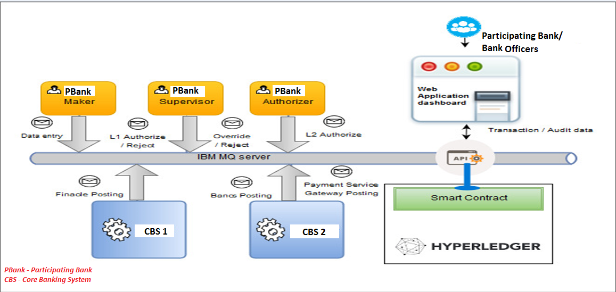
Remittance Transaction Audit Trail – Top Down View
9

Slide 20
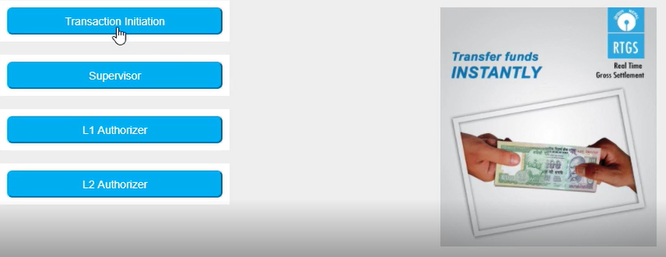
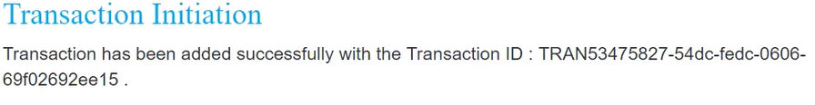
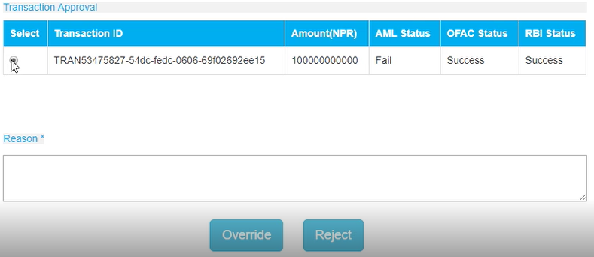
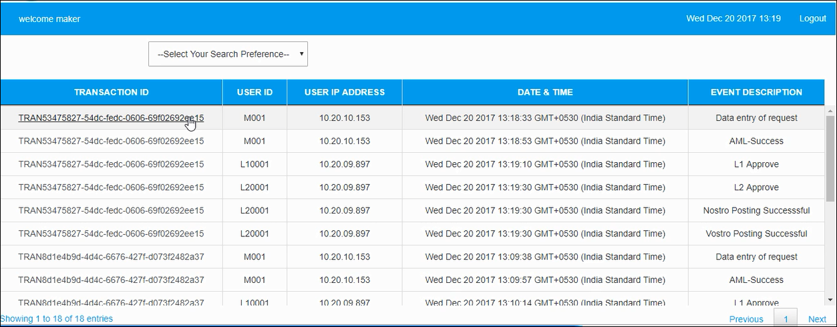
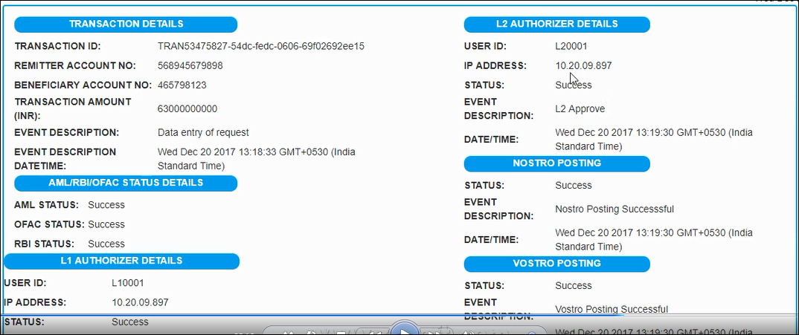
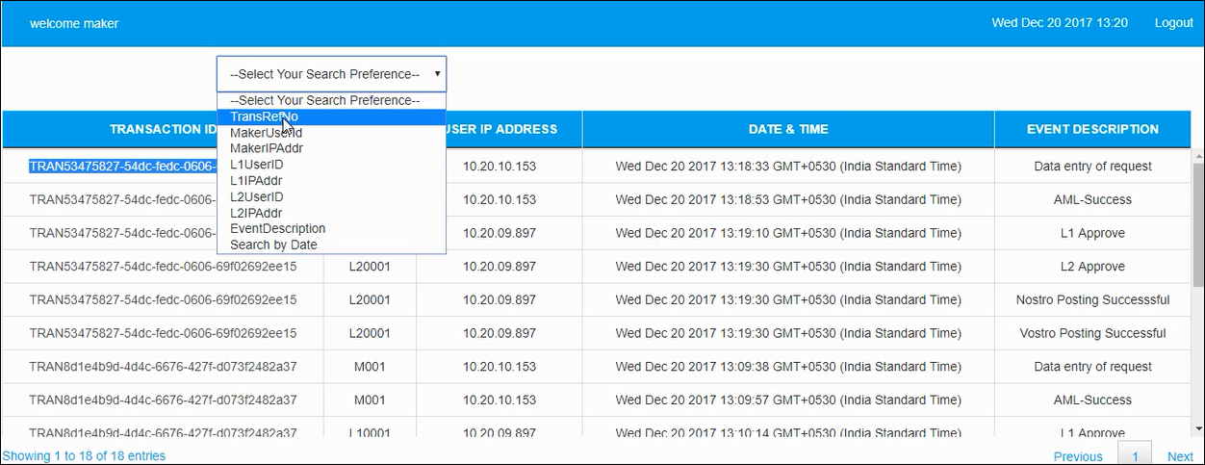
Remittance Transaction – Screen Shots
2. Transaction Generation & Approval
1. Home Page – Transaction Initiation
2. Transaction Generated
3. Reports Section
4. Drill Down Available
5. Audit Data at Multiple Levels
10

Slide 21
Annexure

Slide 22
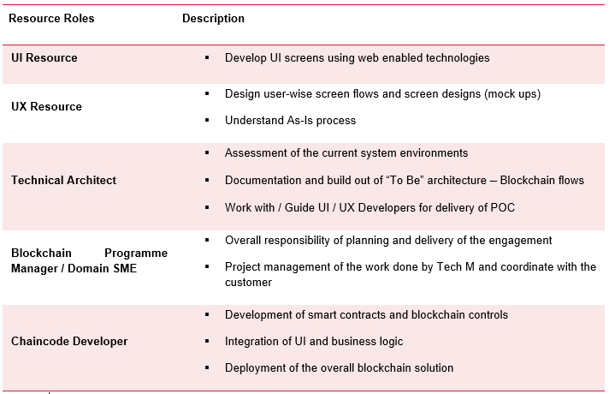
Resourcing (Indicative)

Slide 23
Technical Architecture & Infrastructure Components
Web / Mobile Screens
(UI Development)
Middleware Development (Business Logic – Events - Alerts)
Blockchain Code (Smart Contracts)
UI Development
Node JS
Blockchain
REST API
Smart Contracts
Smart Contracts
Express
Server
Smart Contracts
Angular JS/JQuery
B
A
HTML
Routes
Events
API
EE
Bootstrap
Blockchain API
JSON over HTTP
C
D
IBM Hyperledger Version 0.6 / 1.0 On Premise (RIL Environment)
Peer Nodes – 4 Default as Provided by IBM
Blockchain API Services over Http(s)
Smart Contracts using GO Language
UI Development using HTML5
UX Development using Photoshop
GPRC Connect
Smart Contracts
Smart Contracts
ERP Connect

Slide 24
Thank You
Feel free to contact amey.rajput@techmahindra.com

